Slide 1
Seeing ADHD from Both Sides: Navigating Nuance in How We Talk about ADHD
Dr Tom Nicholson
Northumbria University

Slide 2
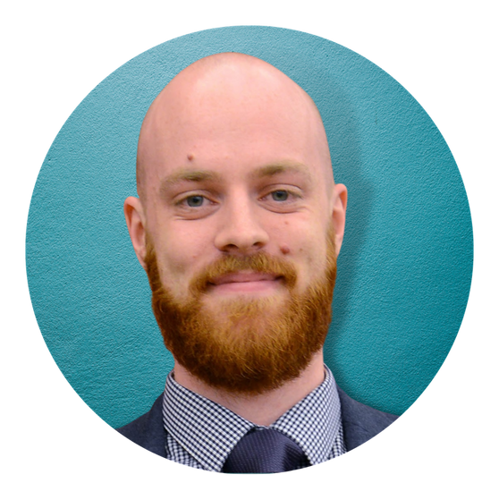
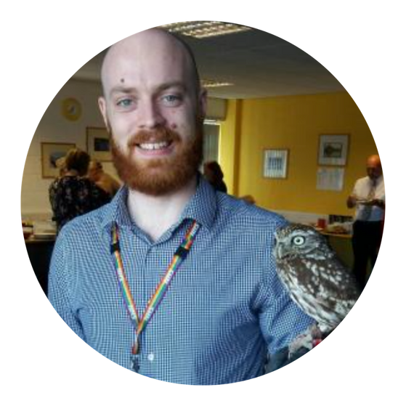
Who I am
Neurodiversity Activist
Keynote Speaker and Trainer
Assistant Professor of Nursing
CAHMS ADHD assessing nurse
Neurodevelopmental Team

Slide 3

Who I am
Diagnosed ADHD at 5. Autistic at 29
Educational trauma

Slide 4
Context
The two dominant paradigms of ADHD (Biomedical versus Neurodiversity) appear contrary with little shared ground between
How we think about ADHD as a society shapes our entire approach to it as a condition
For Researchers: Methodology, theoretical perspective, applicability of findings, readership
For Clinicians: Patient care, interventions and treatment, advice and language
Wider Society: What we should do/fund/accept and acknowledge

Slide 5
ADHD is one of the “most disabling conditions in childhood”
ADHD is a Superpower

Slide 6
Talk Aim: To explore how we can navigate this theoretical tension and develop our own conceptual framework of ADHD

Slide 7
A (brief) introduction to ADHD
One of the most diagnosed childhood conditions affecting ~3-7% of school aged children
Continues into adulthood
Diagnostic criteria
Developmentally atypical levels of;
Inattention
Hyperactivity
Impulsivity

Slide 8
Biomedical Model - Assumptions
ADHD is a heterogeneous neurocognitive (neurodevelopmental) disorder originating in early development
The diagnosis of ADHD is valid and reaches threshold for criteria for ‘disorder’ within psychiatric diagnostic manuals
Those with ADHD have neurocognitive ‘deficits’ and ‘impairments’ which can be reduced through effective medical treatment
Plethora of research demonstrates poor outcomes in all areas of life for those with an ADHD diagnosis
Once diagnostic criteria is met, ADHD becomes a “medical problem”

Slide 9
Benefits of a Biomedical Model
Strong evidence of genetic component Inc. fMRI evidence demonstrating altered brain structure alongside high heritability + twin studies.
Allows for evidence based effective treatments to be used (e.g. stimulant medication)
Clear evidence of improved outcomes for medication users
Significant qualitative evidence of QoL improvements from medicine
Medical diagnosis legitimises the need for intervention and support, enforcing societal response to treat and reduce impairment
Including support within disability legislation and legal protections
Justifies funding and research into more effective treatment, recognition, assessment.

Slide 10
Criticisms of a biomedical construction
Biological reductionism discounts potential exacerbating factors e.g. environmental impact, societal impact on individual
Brain based discourse is “devoid of contextual data” (Laskey et al, 2016).
Subjectivity and value laden perspectives in diagnostic process
What constitutes impact on functioning?
How often is “often”?
Significant variation in minoritised populations within diagnostic trends
Lack of clear-cut boundary between diagnosis and non-diagnosis

Slide 11
Criticisms of a biomedical construction
Linguistic problems
Negative laden language (dysfunction, deficit, disorder, disability) prioritises failings with no acknowledgement of potential benefits
Some have argued for the over-medicalisation of ‘normal’ experience (Need we have a label for everything?)
The colonisation of medicine into everyday life
Patriarchal power dynamics of normality
What about those who don’t get a diagnosis but have ADHD?
Or those who are not represented in the medical research/data?

Slide 12
Neurodiversity paradigm
Stemming from a Social Model of Disability
Frames those with neurodevelopmental conditions as neurological different as opposed to disordered or deficient
Normal variation of humanity
Often (but not always) led by neurodivergent people themselves
Similar to other social justice movements within intersectional spaces

Slide 13
Neurodiversity paradigm
Acknowledges impairment whilst prioritising the societal, environmental, and psychological barriers to inclusion for disabled people
Posits’ neurological diversity as inherently valuable
Challenges dominant power structures present within society

Slide 14
Benefits of the model
Avoid the exclusion of the ‘disabled’ from the ‘non-disabled’
Prioritises neurodivergent strengths e.g
Creativity, enthusiasm, performance within context, individuality
Challenges beliefs of being ‘broken’, ‘disordered’, or ‘less’ than others.
Zooms in on societal barriers to instigate systemic change
Allows some to utilise ‘superpower’ conceptualisations

Slide 15
Criticisms of the paradigm
Can disregard and invalidate the lived experience of disability/impairment
Pollyanna perspectives
What about those who experience significant impairment independent of societal structures?
Less accessible for those with higher support needs?
Often dominated by “successful” or “higher functioning” voices
Severe manifestations of symptoms such as impulse control can be significantly disabling
The dichotomy of positive framing of strengths and benefits versus fighting for support and interventions for those who need them
The contradiction of having ‘differences’ recognised by society whilst also claiming natural variation

Slide 16
Criticisms of the paradigm
Neumeier’s (2018) ‘Neurodiversity Lite’
The adoption of feel-good positive language is used as lip service to avoid actually implementing accommodation and inclusive changes
Is the neurodiversity paradigm simply a white, Eurocentric/global north paradigm?
The paradigm may fail to truly acknowledge the impact of racism, ableism, patriarchy, capitalism, and colonialism.
If neurodiversity is normal and not a medical problem, then why should diagnosis be funded on the NHS?
Clinicians are starting to ask this question…
The defunding of services is a very real concern.

Slide 17


Slide 18
Developing a Theoretical Framework
QUESTIONS TO CONSIDER WHEN DEVELOPING YOUR OWN FRAMEWORK

Slide 19


Slide 20
Implications
In research: clarity on methodology, readership, interpretation, and biases
Clinical care: clarity on treatment, language, patient care and expectations
Lived experience- narrative construction and identity work (giving nuance to people in a world of polarisation)

Slide 21
Conclusions
Neither paradigm adequately fulfils the needs of the people
As social media perspectives emerge and clinicians double down due to constraints, we need more nuanced flexible positions
It’s valuable to acknowledge criticisms of our own positions

Slide 22
Thank You
DR TOM NICHOLSON
NORTHUMBRIA UNIVERSITY
University Work and Research: t.nicholson@northumbria.ac.uk
Business: tom@drtomnicholson.com
LinkedIn: Dr Tom Nicholson PhD
Instagram: @DrTomNicholson

