Slide 1


ADHD Coaching
Dr Esther Barrett
Notes:
How to select and work with an ADHD Coach.
Talking through Coaching Approaches

Slide 2
Finding an ADHD Coach
Working together

Slide 3
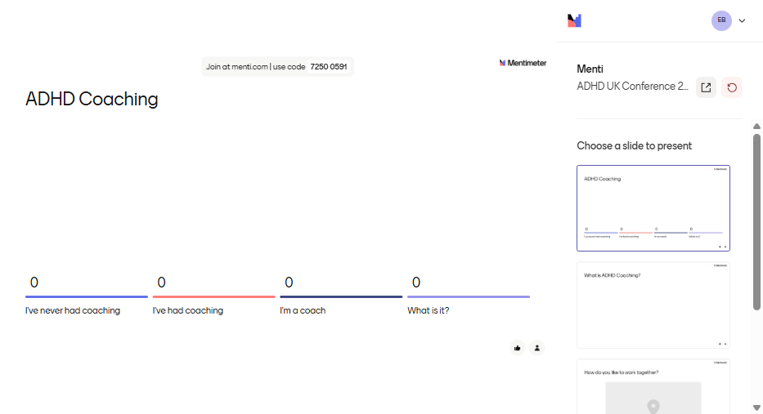

Slide 4

What is ADHD Coaching?

Slide 5
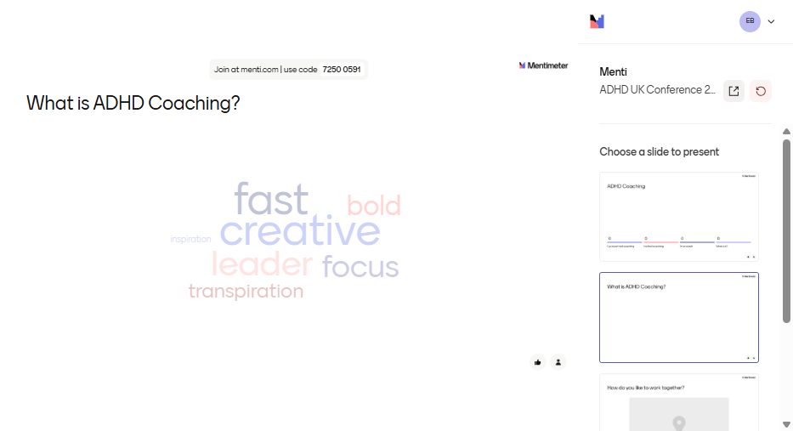

Slide 6
Coaching for
Setting goals
Devising plans
Identifying strengths
Locating barriers and challenges
Addressing unhelpful, limiting or negative thinking
Creating and practising new habits
Developing resilience

Slide 7

Finding an ADHD Coach

Slide 8
ADHD UK Marketplace
Life Coach Directory
Specialist companies
Social media and community recommendations
Notes:
Where you might find a coach
https://store.adhduk.co.uk/adhd-uk-marketplace/
https://www.lifecoach-directory.org.uk/

Slide 9
Qualifications
Experience
Specialist accredited course
Notes:
Questions to ask
What experience does the coach have?
Is the coach qualified, and have they done a specialist ADHD or neurodiversity coach training course?
Was the course accredited by a professional coaching body (AC, UCA, ICF, EMCC) or the ILM?
If so, you can be confident that the course is built on a professional competency framework and a code of ethics.

Slide 10
Professional body membership
Association for Coaching (AC)
Universal Coaching Alliance (UCA)
International Coaching Federation (ICF)
European Mentoring and Coaching Council (EMCC)
Notes:
Questions to ask
Is the coach a member of a professional coaching body?
If so, they will be committed to working to a competency framework and a code of ethics.
They will also be undertaking regular supervision and continuing professional development.
They might be working towards individual accreditation with the professional body.

Slide 11

Working together

Slide 12
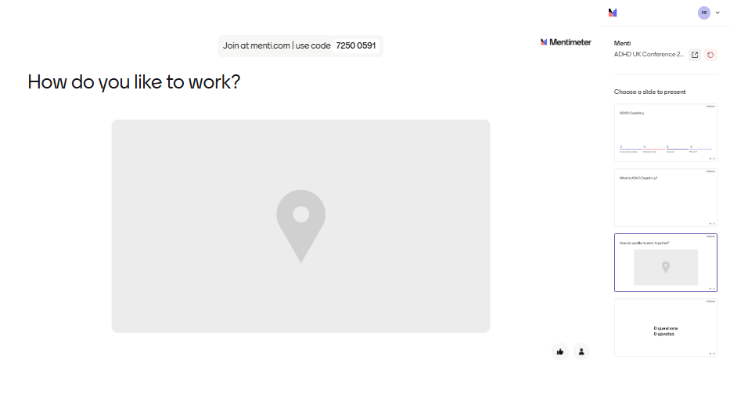

Slide 13
Online profile
Notes:
Have a look at their website, socials, reviews, testimonials
Notice their style, marketing and promotion techniques, authenticity and values

Slide 14
Discovery / Chemistry Call
Notes:
Have a discovery call with 2 or 3 coaches
Notice rapport, values, connection, empathy, energy

Slide 15
Approaches
Duration
Kind of work
Models and tools
Notes:
Questions to ask
How long are the sessions and how long will we work together?
How do you work with clients? Journaling, worksheets, homework / tasks, strategies, exploration, suggestions, advice and guidance
What kind of models or tools do you use? GROW, wheel of life, activities, talking and discussion, grounding techniques, scaling, traffic lights, open questions, clean questions, guided questions

Slide 16
Directive / non-directive coaching
Structure
Scaffolding
Guidance

Slide 17
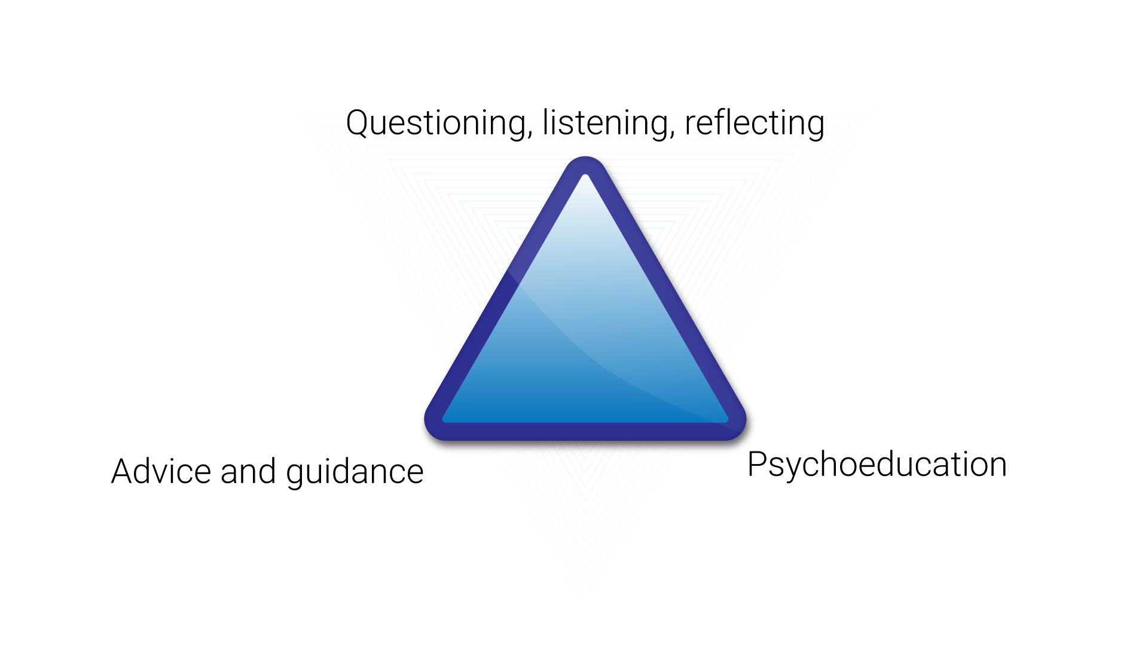
Copyright Esther Barrett 2023
Notes:
https://barrettcoachingandtraining.com/2024/06/06/the-adhd-coaching-triangle/

Slide 18
Specialisms
Parents | couples | teenagers | hormones | workplace | burnout | nature | walking | LGBTQ+ | holistic therapies | hypnotherapy | somatic | equine |

Slide 19
Therapeutic Coaching
Notes:
This is a growing field, and many ADHD clients and coaches like the blend of past and present, combining processing with strategizing

Slide 20

Notes:
Ask Me Anything

Slide 21
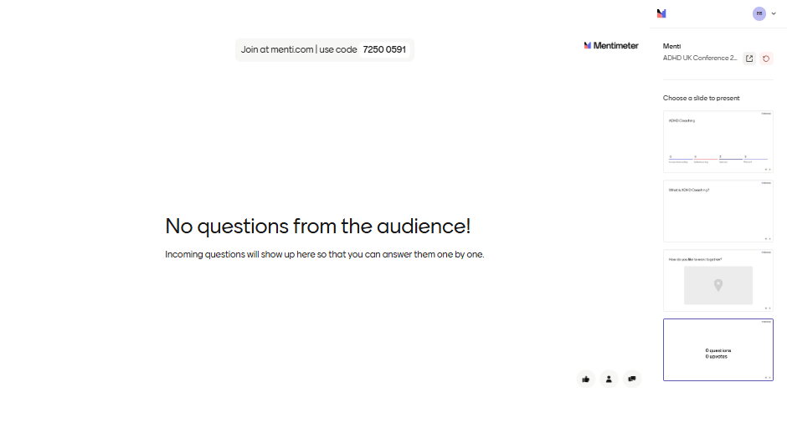

Slide 22

Notes:
**Links**
ADHD UK support groups
https://adhduk.co.uk/support/
ADHD UK marketplace
https://store.adhduk.co.uk/adhd-uk-marketplace/
Life Coach Directory
https://www.lifecoach-directory.org.uk/
Therapeutic Coaching network
https://www.linkedin.com/groups/13271031/
Community for ADHD and ND coaches and clients looking for low cost or free coaching from newly qualified coaches
https://trueorbitcollective.com/
hello@trueorbitcollective.com
Blog
https://barrettcoachingandtraining.com/blog-2/
Podcast
https://www.youtube.com/@ADHD-Generations/videos

Slide 23
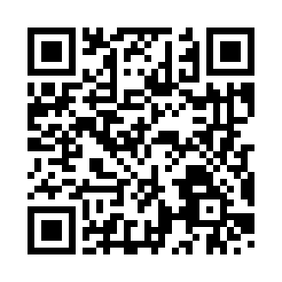
Notes:
**Links**
ADHD UK support groups
https://adhduk.co.uk/support/
ADHD UK marketplace
https://store.adhduk.co.uk/adhd-uk-marketplace/
Life Coach Directory
https://www.lifecoach-directory.org.uk/
Approach – the coaching triangle
https://barrettcoachingandtraining.com/2024/06/06/the-adhd-coaching-triangle/
Therapeutic Coaching network
https://www.linkedin.com/groups/13271031/
Community for ADHD and ND coaches and clients looking for low cost or free coaching from newly qualified coaches
https://trueorbitcollective.com/
hello@trueorbitcollective.com
Blog
https://barrettcoachingandtraining.com/blog-2/
Podcast
https://www.youtube.com/@ADHD-Generations/videos

Slide 24
Thank you
esther@barrettcoachingandtraining.com

